Slide 1


BITHUB
MINI Project (BCS-351)
MINI PROJECT PRESENTATION ON
Submitted by
AYUSH KUMAR (2300971520058)
ARYA OJHA (23009715200)
ASHISH MAURYA (2300971520051)
AKSHAT CHAUDHARY (2300971520023)
Under the Supervision of
DR. KUMAR PRATEEK
Galgotias College of Engineering & Technology
Greater Noida, Uttar Pradesh
Mini Project (BCS-351) ODD Semester 2024-25

Slide 2
OUTLINE
Introduction
Literature survey
Problem statement and objectives
Methodology
Implementation
Testing & Results
Conclusion
References
Mini Project (BCS-351) ODD Semester 2024-25

Slide 3
INTRODUCTION
Bithub: A web-based BitTorrent platform, no software needed.
Instant access: Download and share torrents directly from your browser.
Cross-platform: Fully functional on both desktop and mobile.
Visually stunning: Unique robotic animations and 3D effects for an engaging UI.
In-site video playback: Watch your downloaded videos directly on the website.
Faster, simpler, and more interactive file sharing experience.
Mini Project (BCS-351) ODD Semester 2024-25

Slide 4
Literature survey
BitTorrent, developed in 2001, revolutionized file sharing by enabling peer-to-peer (P2P) distribution, reducing reliance on centralized servers.
Many existing platforms like uTorrent and qBittorrent offer desktop-based torrent clients, but they lack modern, web-based interfaces.
Web-based torrent platforms like WebTorrent have emerged, allowing browser-based file sharing without additional software.
Mini Project (BCS-351) ODD Semester 2024-25

Slide 5
Literature survey
User experience in existing torrent platforms is often criticized for outdated designs and complexity.
Adding animations and interactive UI elements in web platforms has been shown to enhance user engagement and retention.
Bithub introduces a fresh approach, combining ease of access with an innovative, visually appealing interface
Mini Project (BCS-351) ODD Semester 2024-25

Slide 6
PROBLEM STATEMENT AND Objectives
Problem:
Existing BitTorrent platforms often require software installation, have outdated UIs, and lack ease of use and mobile support.
Objectives:
Develop a web-based, no-installation-required BitTorrent platform for both mobile and desktop.
Implement drag-and-drop functionality for torrent file uploads and the ability to copy magnet links.
Create a user-friendly interface with robotic animations and 3D visuals.
Allow users to download, share, and watch videos seamlessly on the platform.
Mini Project (BCS-351) ODD Semester 2024-25

Slide 7
METHADOLOGY
Study Design: Web-based platform development for BitTorrent file sharing.
Study Settings: Web and mobile environments.
Sampling: User testing with diverse demographics.
Variables: User engagement, download speed, UI effectiveness.
Controls: Standardized testing conditions across platforms.
Mini Project (BCS-351) ODD Semester 2024-25

Slide 8
METHADOLOGY
Methods: UI design, coding, and integration of animations.
Data Collection: User feedback and performance metrics.
Data Analysis: Comparative analysis of user engagement and platform performance.
Ethical Clearance: Ensured user privacy and data security.
Mini Project (BCS-351) ODD Semester 2024-25

Slide 9

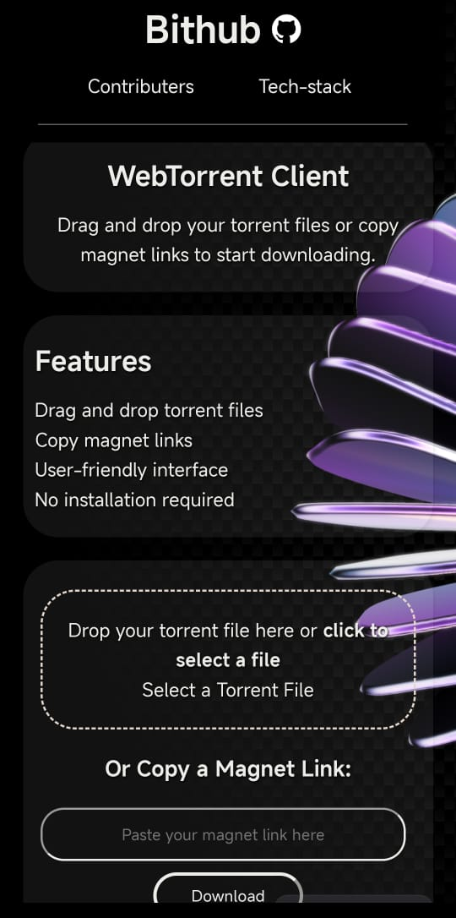
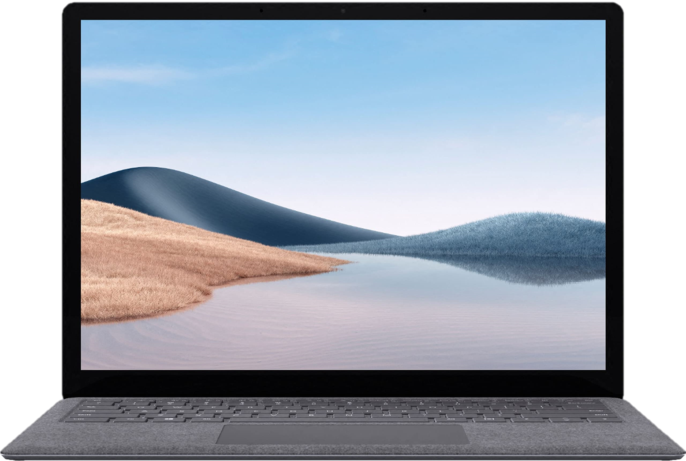
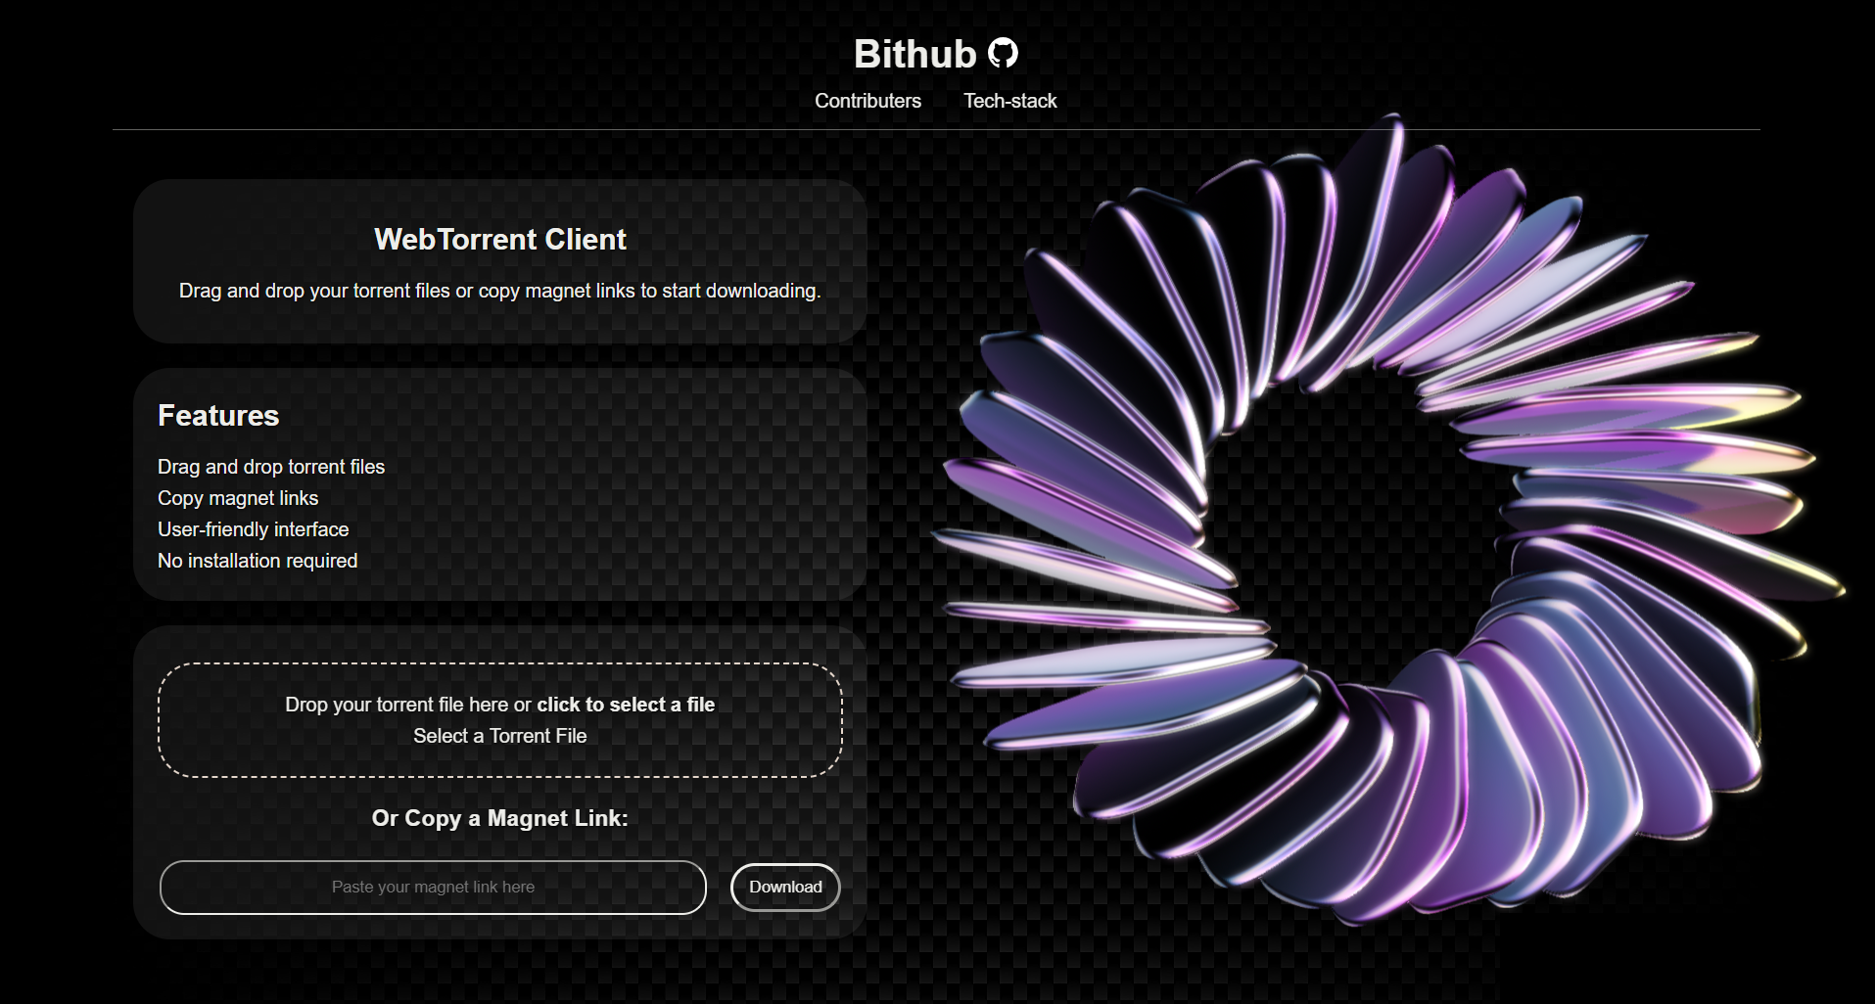
IMPLEMENTATION
Platform Development: Built using HTML, CSS, JavaScript for responsive design.
Core Features: Integrated drag-and-drop file upload, magnet link copying, and in-site video playback..
Cross-Platform Compatibility: Ensured functionality on both mobile and desktop devices.
Mini Project (BCS-351) ODD Semester 2024-25

Slide 10
TESTING AND REsULT
Testing and Results
Usability Testing: Evaluated ease of navigation, upload, and download functionality with a group of 20 users.
Stress Testing: Tested platform stability under heavy file-sharing loads to ensure reliability.
Mobile Optimization: Verified responsiveness and seamless performance on various mobile devices and browsers.
Animation Performance: Analyzed the smoothness of robotic and 3D animations across devices without lag.
Key Results:
Smooth performance for files up to 50GB.
Zero crashes during stress tests.
Mini Project (BCS-351) ODD Semester 2024-25

Slide 11
CONCLUSION AND FUTURE SCOPE
Conclusion: Bithub successfully delivers a web-based BitTorrent platform with innovative UI, seamless cross-platform compatibility, and user-friendly features like drag-and-drop uploads and in-site video playback.
Future Scope:
Incorporate real-time file streaming.
Add user accounts for personalized experiences.
Enhance AI-driven recommendations for files.
Mini Project (BCS-351) ODD Semester 2024-25

Slide 12
REFERENCES
Official BitTorrent Documentation – Overview of peer-to-peer file sharing protocols.
WebTorrent Project – Insights on browser-based torrent solutions.
W3Schools & MDN Web Docs – Frontend development guidelines for HTML, CSS, and JavaScript
.
UI/UX Design Resources – Principles of engaging user interface design.
User Feedback Reports – Data collected during testing phases.
Mini Project (BCS-351) ODD Semester 2024-25

Slide 13
We appreciate your time and attention. Feel free to ask questions or share your feedback. Team Bithub "Redefining file sharing with innovation and simplicity."
THANKYOU!
Mini Project (BCS-351) ODD Semester 2024-25

